Slide 1

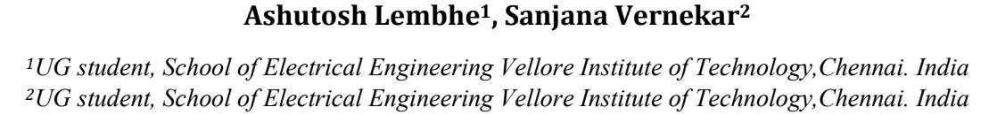
Image Processing to Manipulate RGB Values Using Verilog
Presenter: Po-Yu Huang
UID:117684681

Slide 2
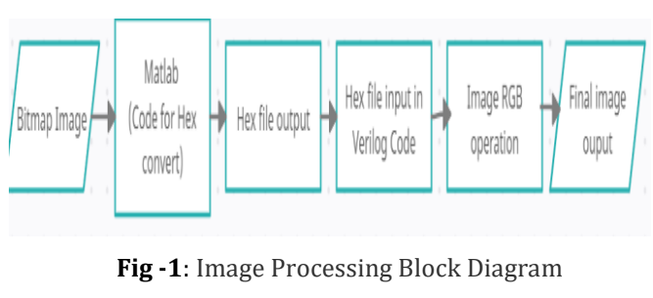
Paper Demonstrate
Implementing the image processing in the Verilog code. This paper have showed how they converted an image in a hex file using MATLAB and then used the hex file in Verilog coding to perform some image processing operations.
Inversion operations: RGB - 255
Brightness operations: RGB + value
Threshold operations: if (RGB > Threshold): RGB = 255
Figure from paper:
https://www.irjet.net/archives/V5/i5/IRJET-V5I5341.pdf

Slide 3
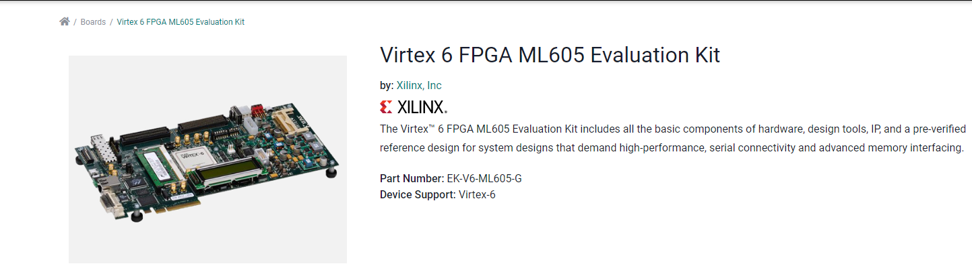
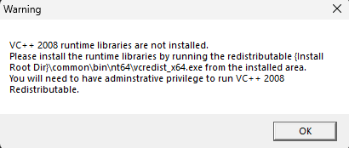
Constrains and difficulties
Verilog can’t read image directly much change to hexadecimal form. (bmp -> hex)
2. This paper is designed to simulate the code to simulate on virtual board environment. For this project, the virtual simulation is on VIRTEX 6 FPGA board. They run the simulation on Xilinx ISE. It used to simulate on Xilinx ISE, trying to simulating it on Xilinx Vivado.
Figure from Xilinx:
https://www.xilinx.com/products/boards-and-kits/ek-v6-ml605-g.html#specifications

Slide 4
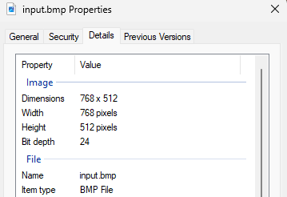
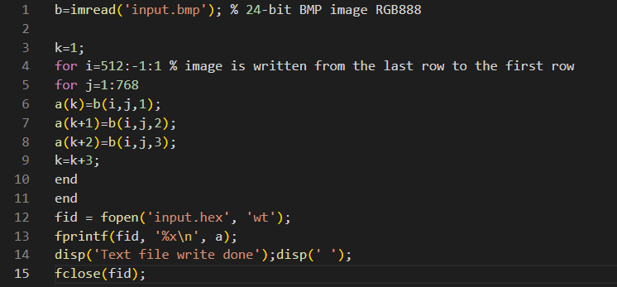
Part 1
Changing bitmap to hexadecimal. This part is written in MATLAB.

Slide 5
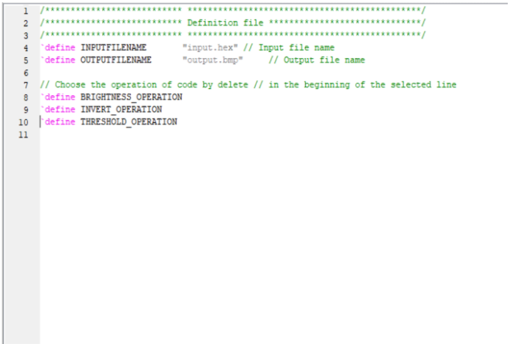
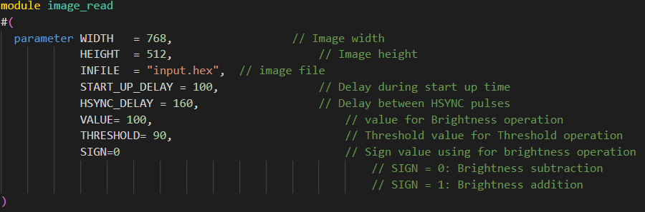
Part 2: Image Processing
Defining the inputs that need to operate the image processing.

Slide 6
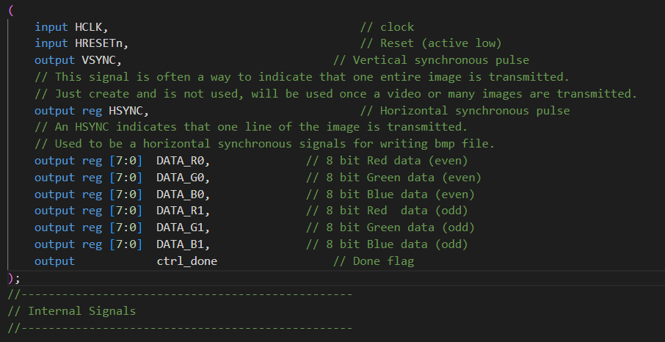
Process and transmit 2 pixels in parallel to make the process faster, you can modify to transmit 1 pixels or more if needed
Notes:
VSYNC: vertical synchronizing pulse
HSYNC: horizontal synchronizing pulse
This purpose is to create a Verilog model of am image sensor or camera in the case that you want to test your image processing algorithm, with your real-time image or video processing

Slide 7
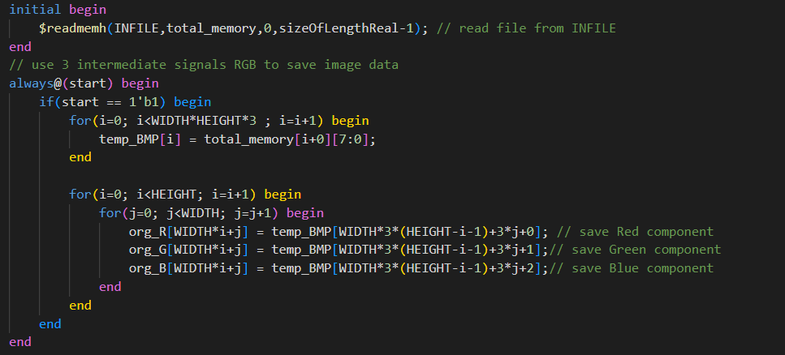

Slide 8
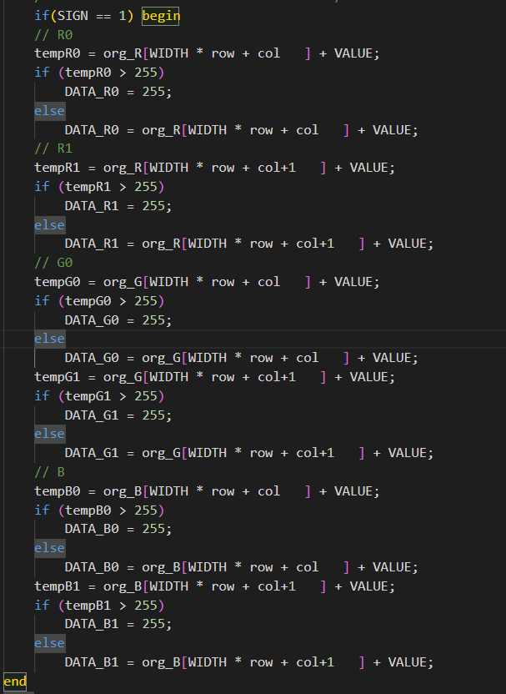
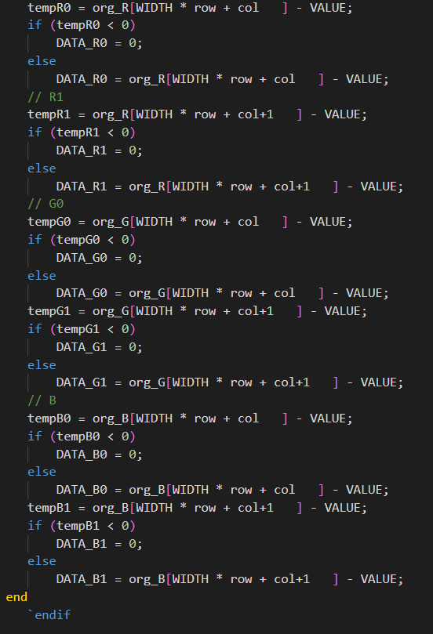
Brightness addition and subtraction

Slide 9
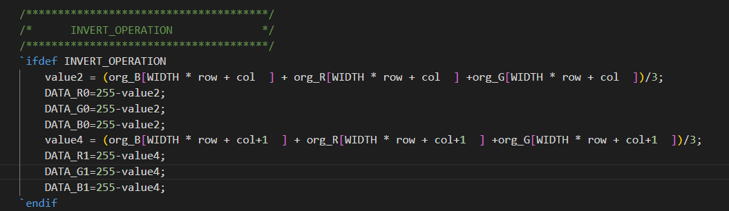
Invert Operation

Slide 10
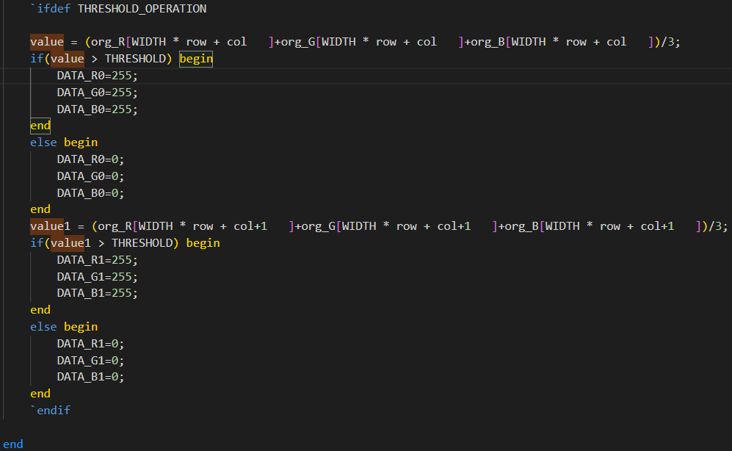
Threshold Operation

Slide 11
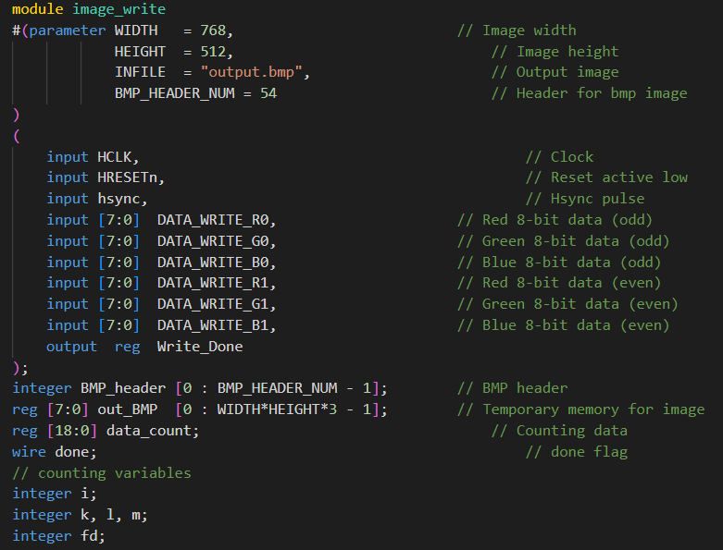
Part 3: Write out the image
Notes:
This pulse is high it means that the data is valid.

Slide 12
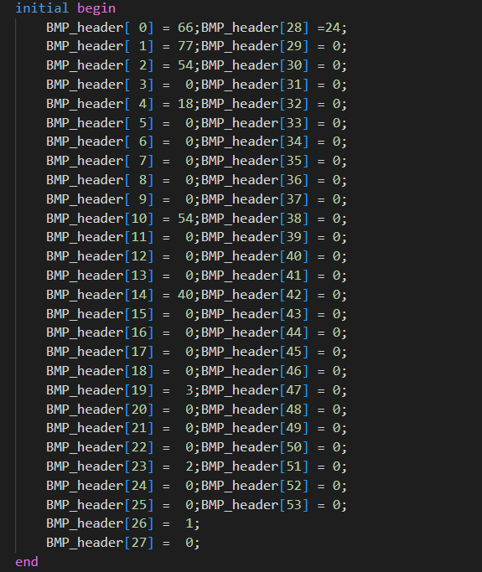
BMP format
The file header (14 bytes) contains information about file size and location at which data is stored.
The Image header (40 bytes*) tells information about rows and columns of an image, bits per pixel, type of compression used if any

Slide 13
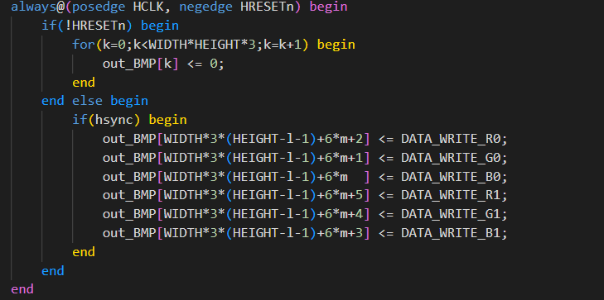

Slide 14
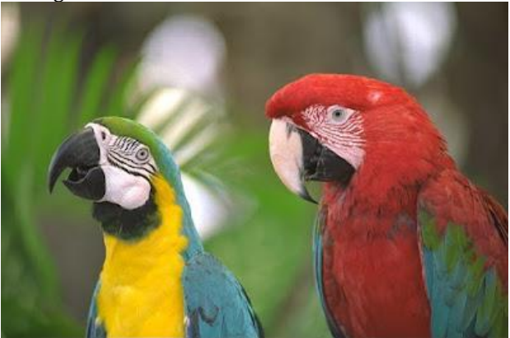
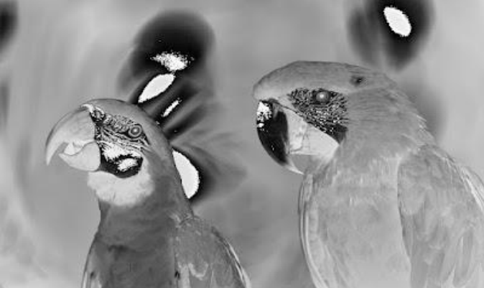
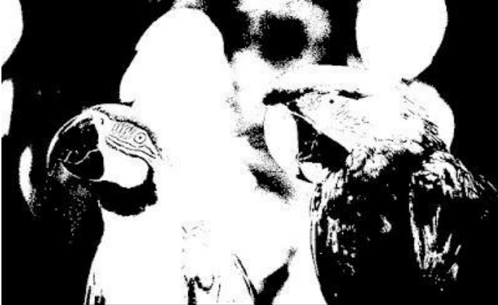
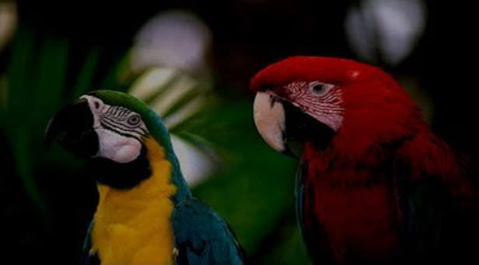

Slide 15
What else can I do?
Edge detection? Sobel, Canny

